Slide 1
Rethinking Outreach Strategies on a HRSA Budget
Keshia Bradford, MPA
©2016 Health Center Association of Nebraska
HCAN is supported in part by a cooperative agreement from the Health Resources and Services Administration’s Bureau of Primary Health Care, award#U58CS21504-01-02.

Slide 2
Overview
Introduction
Overview of HRSA Outreach funding
Outreach & Enrollment funding 2013
One-time funding 2014
Continued funding in 330 base funding
Funding Uses
What can you do with HRSA funding?
Why Outreach?
Why is outreach important?

Slide 3
Overview
Overview of enrollment numbers
Past Enrollment numbers
Outreach possibilities
Nebraska example
Outreach Activity
Discussion

Slide 4
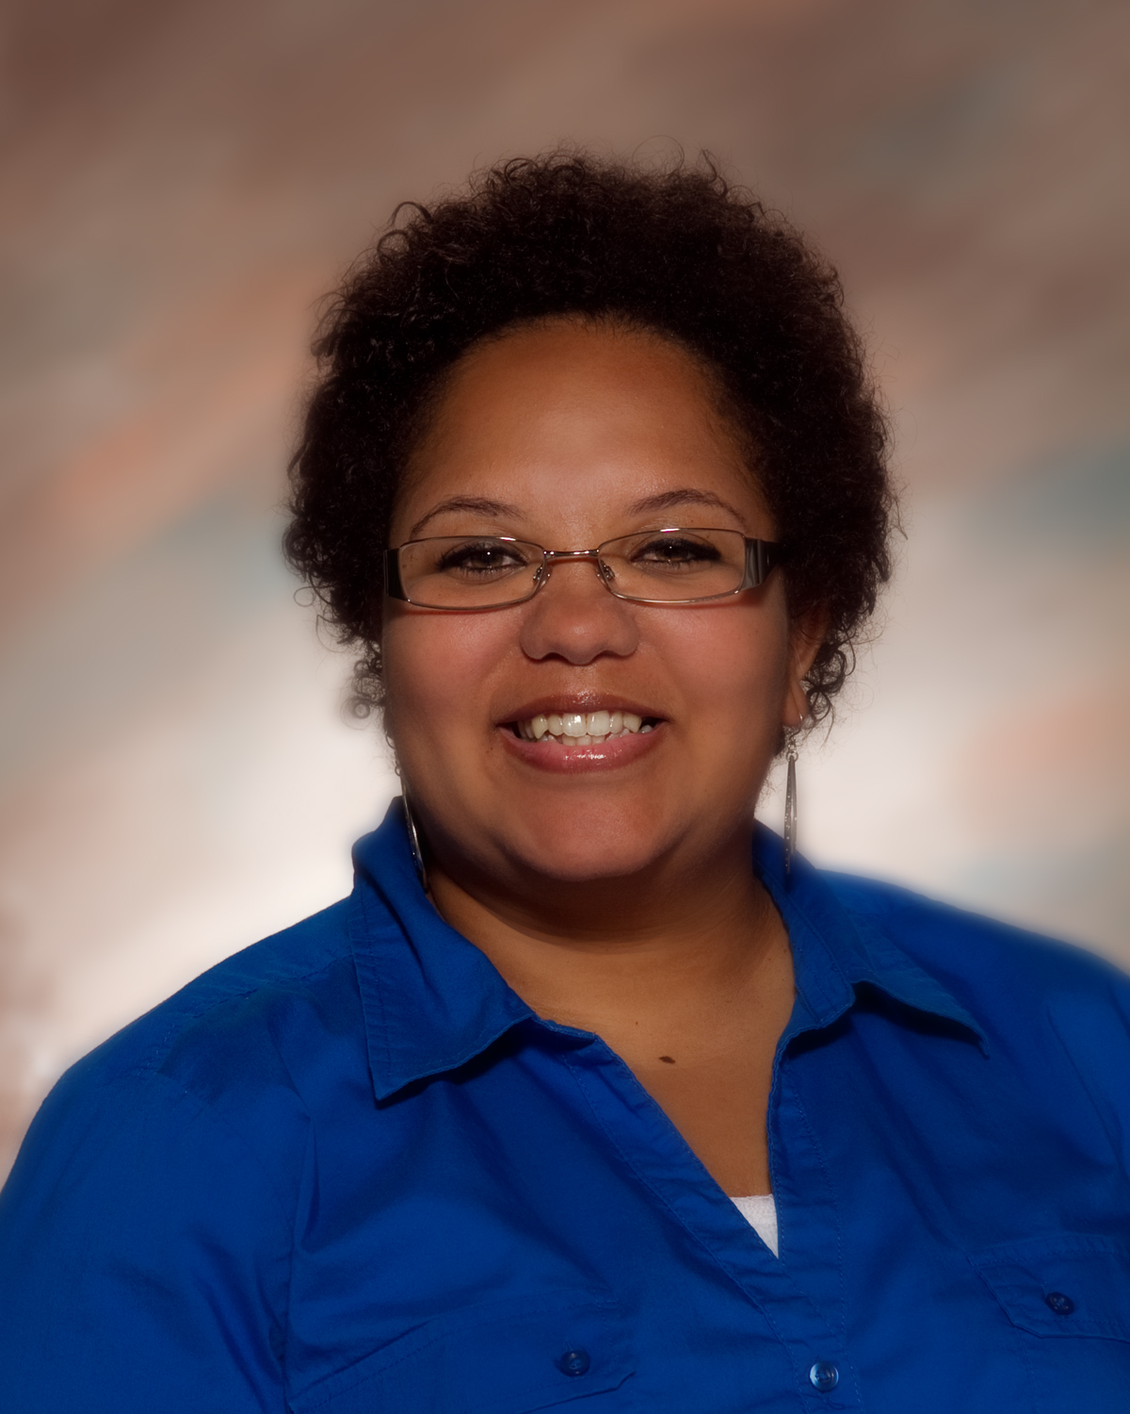
Introduction
Keshia Bradford, MPA
Director of Outreach & Enrollment/Strategic Initiatives
Pursuing doctoral degree in Leadership

Slide 5
Introduction (cont.)
Educational background in healthcare
Health center experience
Provide training and technical assistance to 7 health centers in Nebraska
Outreach and Enrollment
Special populations
Emergency Preparedness

Slide 6
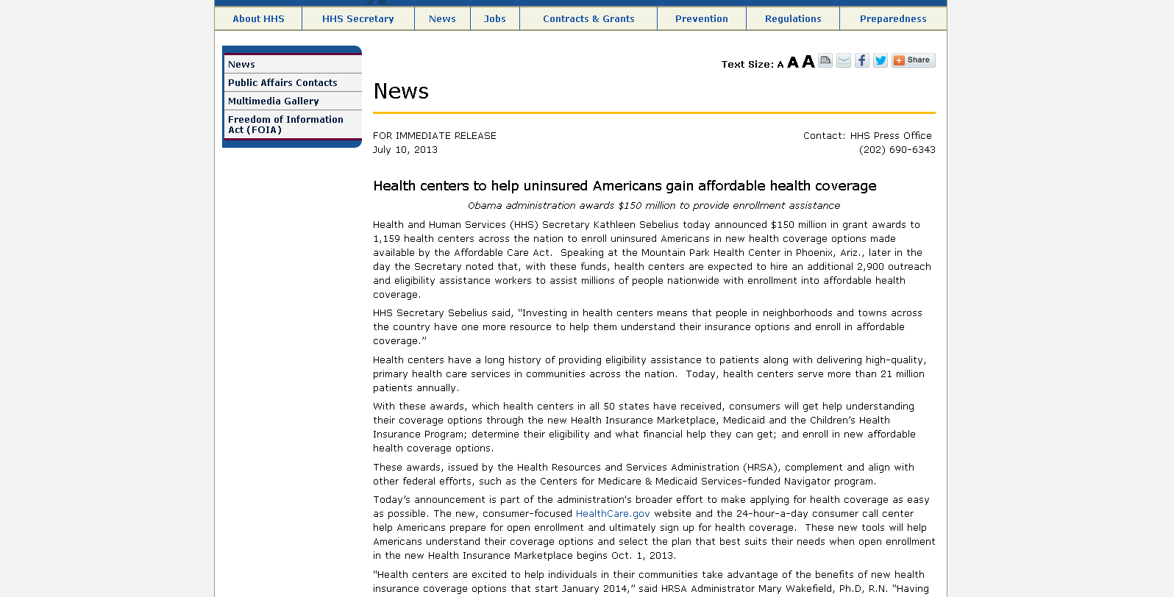
Overview of HRSA Outreach funding
As a review:
Awarded back in 2013 (1st round)
Retrieved from: http://bphc.hrsa.gov/outreachandenrollment/HRSA-13-279.pdf

Slide 7
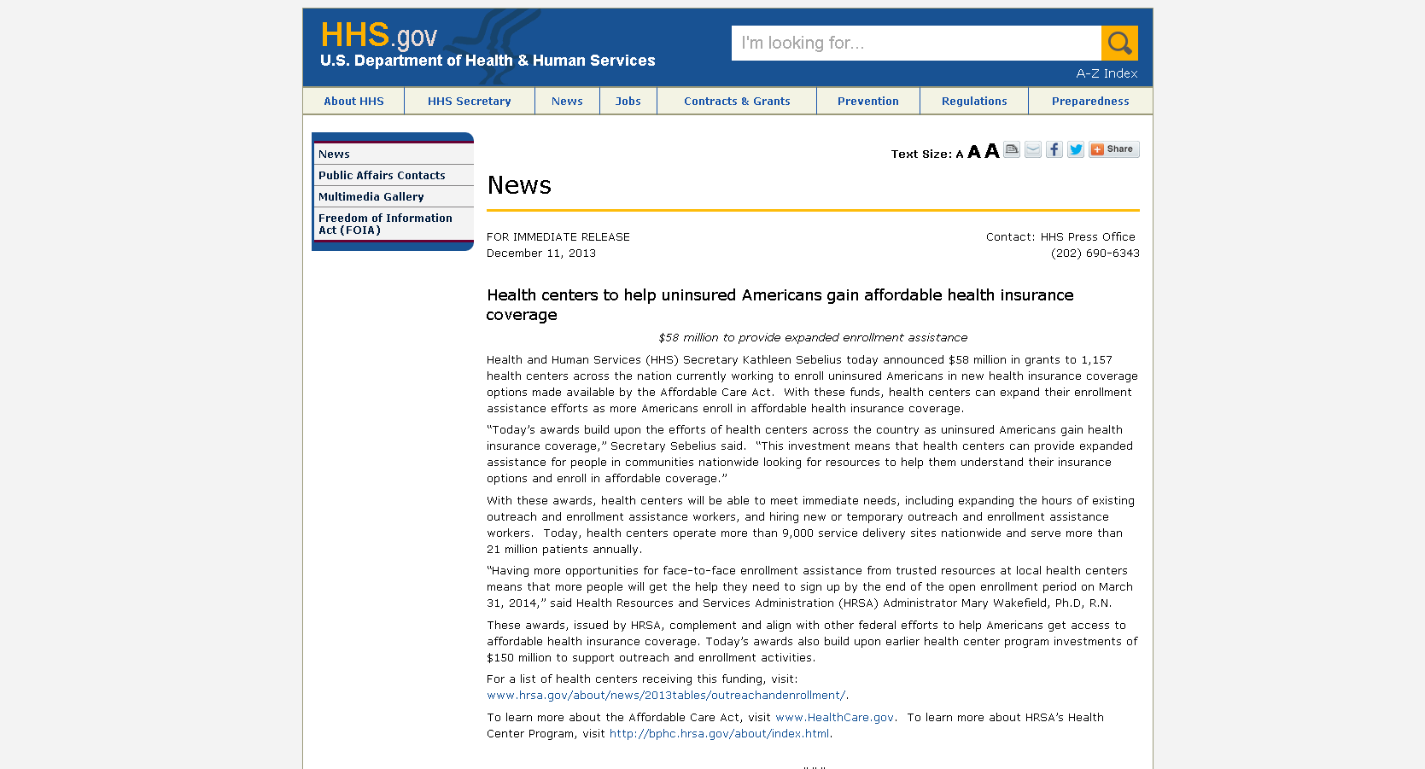
Overview of HRSA Outreach funding
One-time funding: Jan. 2014 (2nd round)
Retrieved from: http://bphc.hrsa.gov/outreachandenrollment/HRSA-13-279.pdf

Slide 8
Overview of HRSA Outreach funding
Total: $2,193,970 in FY 14
Health Center | City | FY 14 Award Amount
BERKS COMMUNITY HEALTH CENTER | Reading | $30,866
B-K HEALTH CENTER, INC. | Hallstead | $33,463
BROAD TOP AREA MEDICAL CENTER | Broad Top | $28,248
CENTERVILLE CLINIC INC | Fredericktown | $146,779
CHESPENN HEALTH SERVICES | Chester | $52,223
COMMUNITY HEALTH AND DENTAL CARE, INC. | Pottstown | $39,273
COMMUNITY HEALTH CLINIC, INC. | New Kensington | $33,330
COMMUNITY HEALTH NET | Erie | $50,018
CORNERSTONE CARE, INC. | Greensboro | $76,933
COVENANT HOUSE INC | Philadelphia | $61,911
DELAWARE VALLEY COMMUNITY HEALTH, INC. | Philadelphia | $114,376
EAST LIBERTY FAMILY HEALTH CARE CENTER | Pittsburgh | $35,668
ESPERANZA HEALTH CENTER, INC. | Philadelphia | $35,332
FAMILY FIRST HEALTH CORPORATION | York | $68,610
GREATER PHILADELPHIA HEALTH ACTION, INCORPORATED | Philadelphia | $142,852
HAMILTON HEALTH CENTER, INC. | Harrisburg | $74,938
HYNDMAN AREA HEALTH CENTER INC | Hyndman | $33,463
KEYSTONE RURAL HEALTH CENTER | Chambersburg | $83,807
KEYSTONE RURAL HEALTH CONSORTIA INC | Emporium | $31,706
LA COMUNIDAD HISPANIA, INC | Kennett Square | $40,078
NEIGHBORHOOD HEALTH CENTERS OF LEHIGH VALLEY | ALLENTOWN | $34,338
NORTH SIDE CHRISTIAN HEALTH CENTER | Pittsburgh | $37,194
PRIMARY CARE HEALTH SERVICES INC | Pittsburgh | $70,248
PRIMARY HEALTH NETWORK, INC. | Sharon | $215,792
PUBLIC HEALTH MANAGEMENT CORPORATION | Philadelphia | $58,558
QUALITY COMMUNITY HEALTH CARE, INC. | Philadelphia | $55,653
RESOURCES FOR HUMAN DEVELOPMENT, INC. | Philadelphia | $71,879
RURAL HEALTH CORPORATION OF NORTHEASTERN PENNSYLVANIA | WILKES BARRE | $68,862
SAYRE HEALTH CENTER | Philadelphia | $28,059
SCRANTON PRIMARY HEALTH CARE CENTER, INC. | Scranton | $40,456
SOUTHEAST LANCASTER HEALTH SERVICES, INC. | Lancaster | $52,335
SPECTRUM HEALTH SERVICES, INC. | Philadelphia | $41,457
SQUIRREL HILL HEALTH CENTER | Pittsburgh | $33,120
STO-ROX NEIGHBORHOOD HEALTH COUNCIL INC | Mc Kees Rocks | $29,963
SUSQUEHANNA COMMUNITY HEALTH AND DENTAL CLINIC, INC. | Williamsport | $35,815
UNIVERSITY OF PITTSBURGH THE | Pittsburgh | $26,974
WAYNE MEMORIAL COMMUNITY HEALTH CENTERS | Honesdale | $40,050
WELSH MOUNTAIN MEDICAL AND DENTAL CENTER | New Holland | $39,343
Retrieved from: http://www.hrsa.gov/about/news/2013tables/outreachandenrollment/pa.html

Slide 9
Overview of HRSA Outreach funding
HRSA Outreach & Enrollment (O&E) Rolled into 330 funding
Employ at least 1 FTE
Retrieved from: http://bphc.hrsa.gov/outreachandenrollment/HRSA-13-279.pdf

Slide 10
Funding Uses
Educating on coverage options-Marketplace, Medicaid, CHIP
Paid media, mailers, and other broad-based strategies
More information can be found at: http://bphc.hrsa.gov/programopportunities/fundingopportunities/outreachenrollment/oefaqs.pdf

Slide 11
Why?
Why is outreach important?
Still remaining uninsured that need our help
In-person assistance is important
Navigating health insurance is challenging

Slide 12
Overview of enrollment numbers
Last Open Enrollment Period: 439,238 enrollments
How many uninsured remain in the state?
994,000 uninsured in 2015
http://files.kff.org/attachment/fact-sheet-the-pennsylvania-health-care-landscape-april-2016

Slide 13
Outreach possibilities
Partnering is helpful-pool resources
Establishing relationships within the community
Think outside the box
Fast food places
Grocery stores
Laundry mats
State fairs

Slide 14
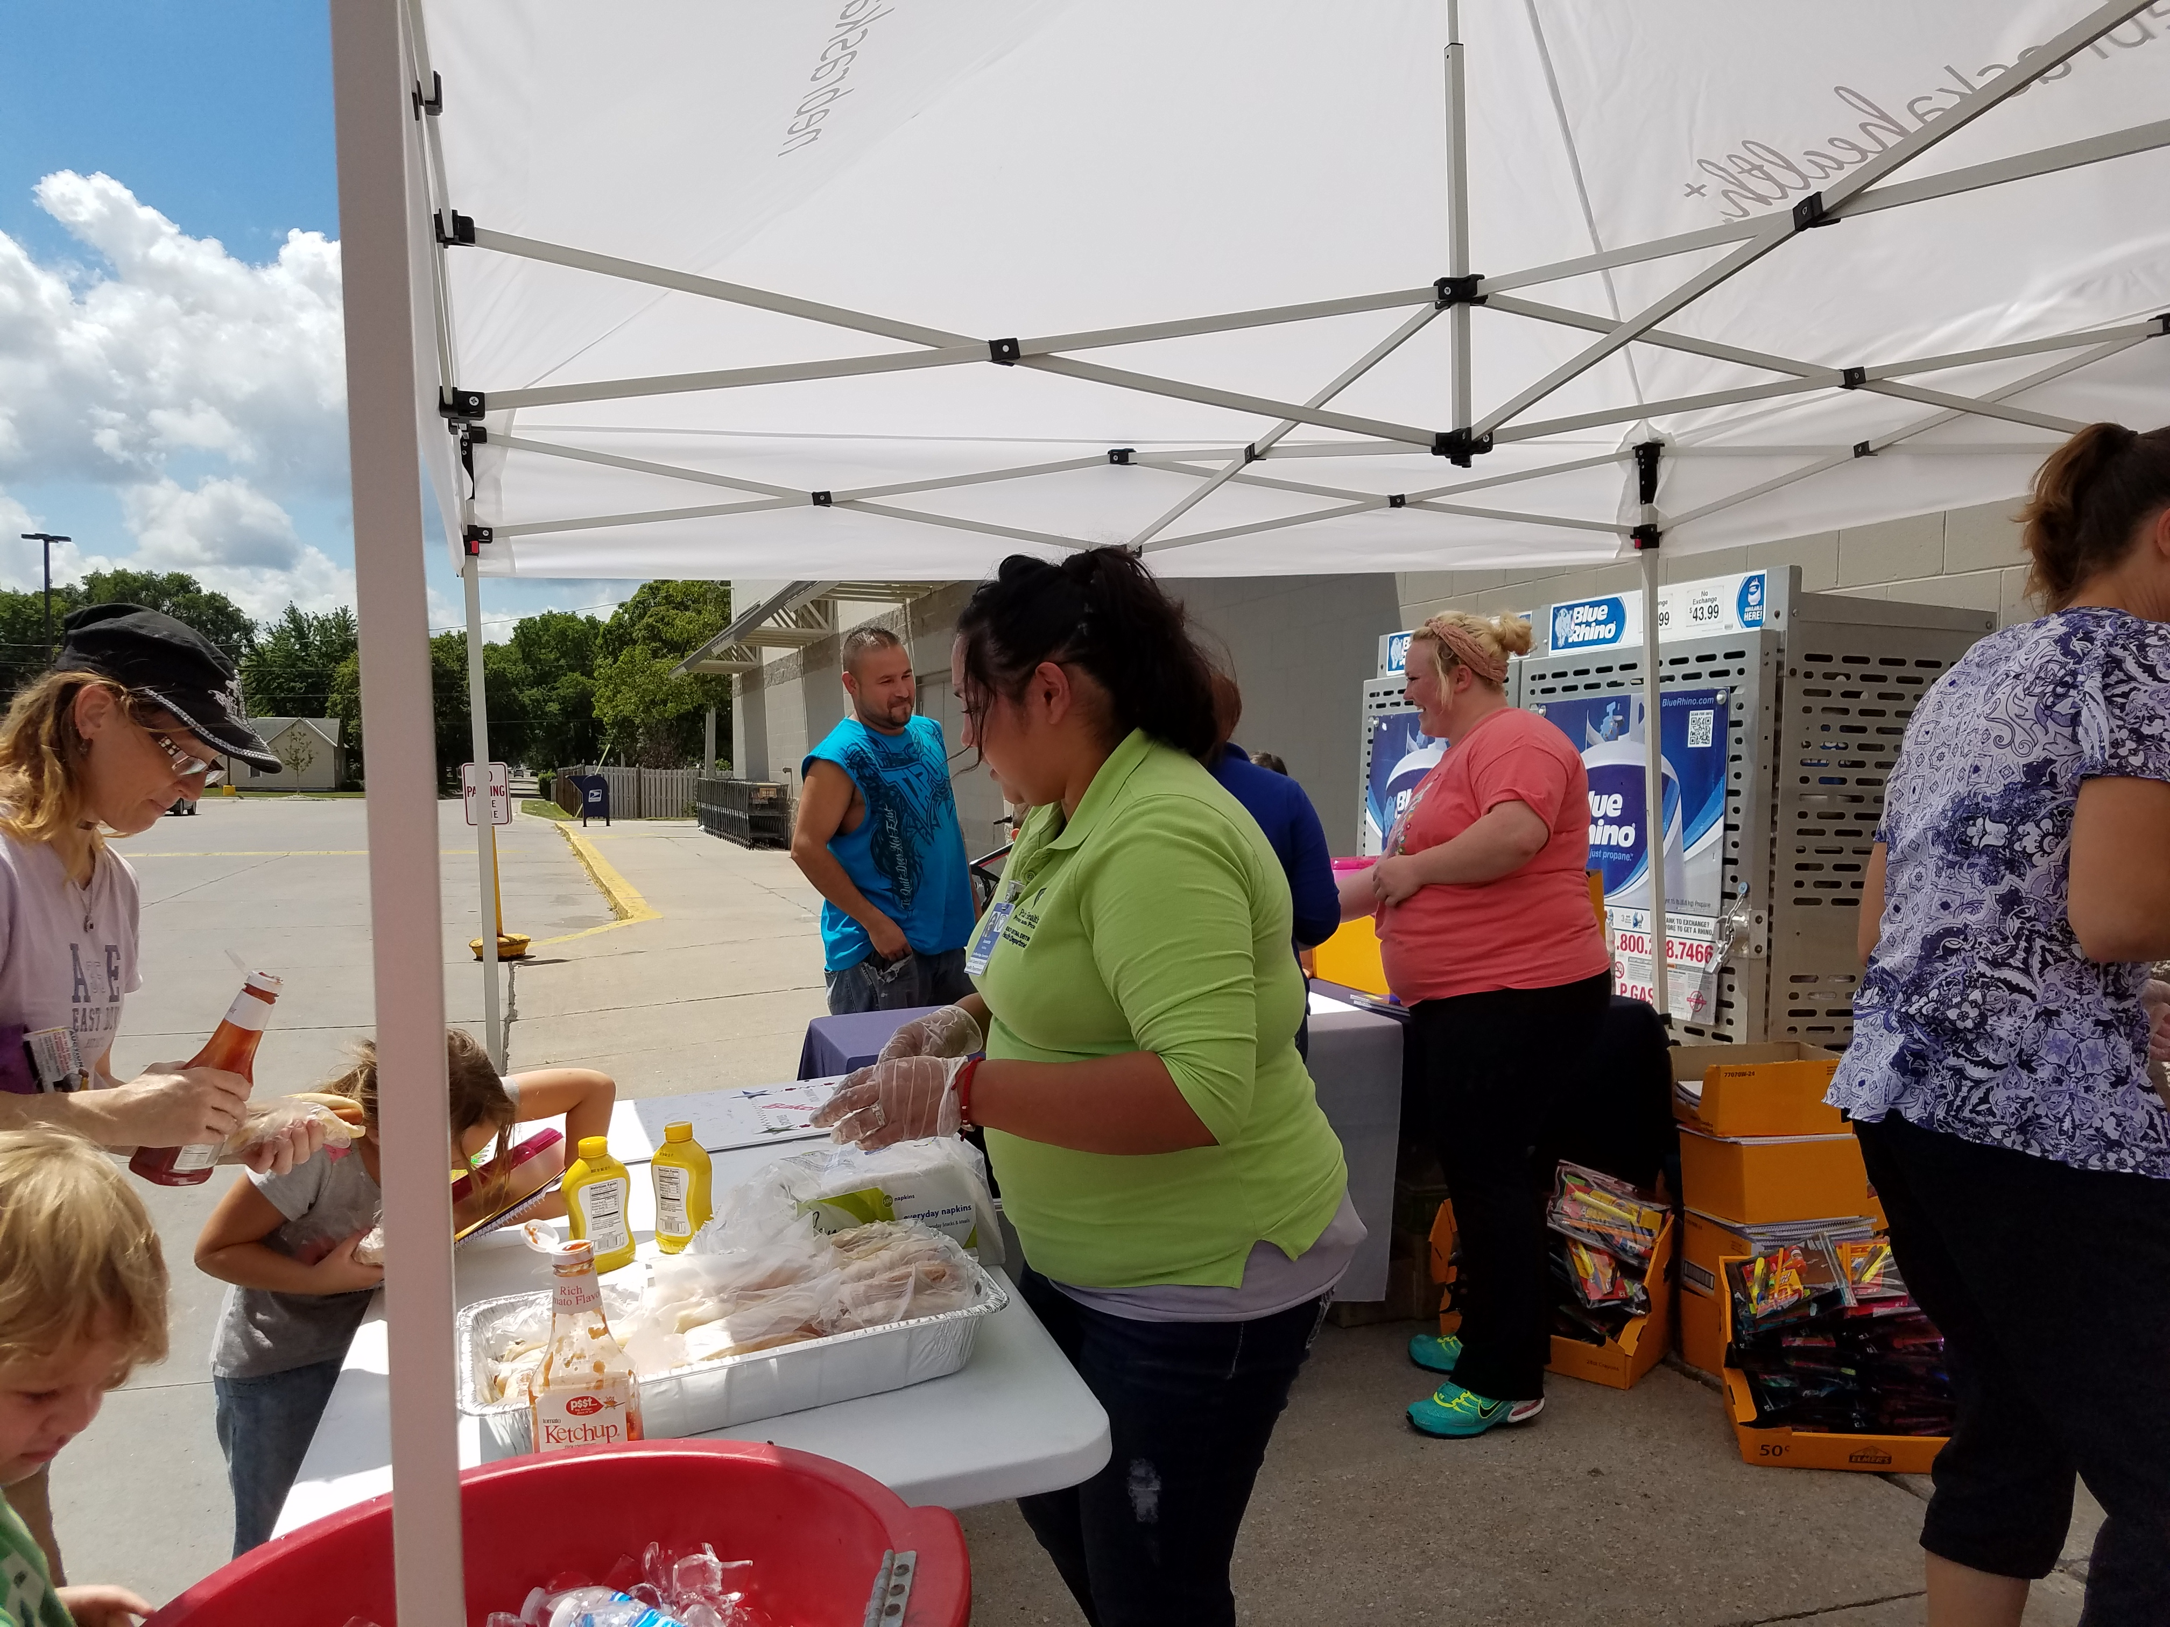
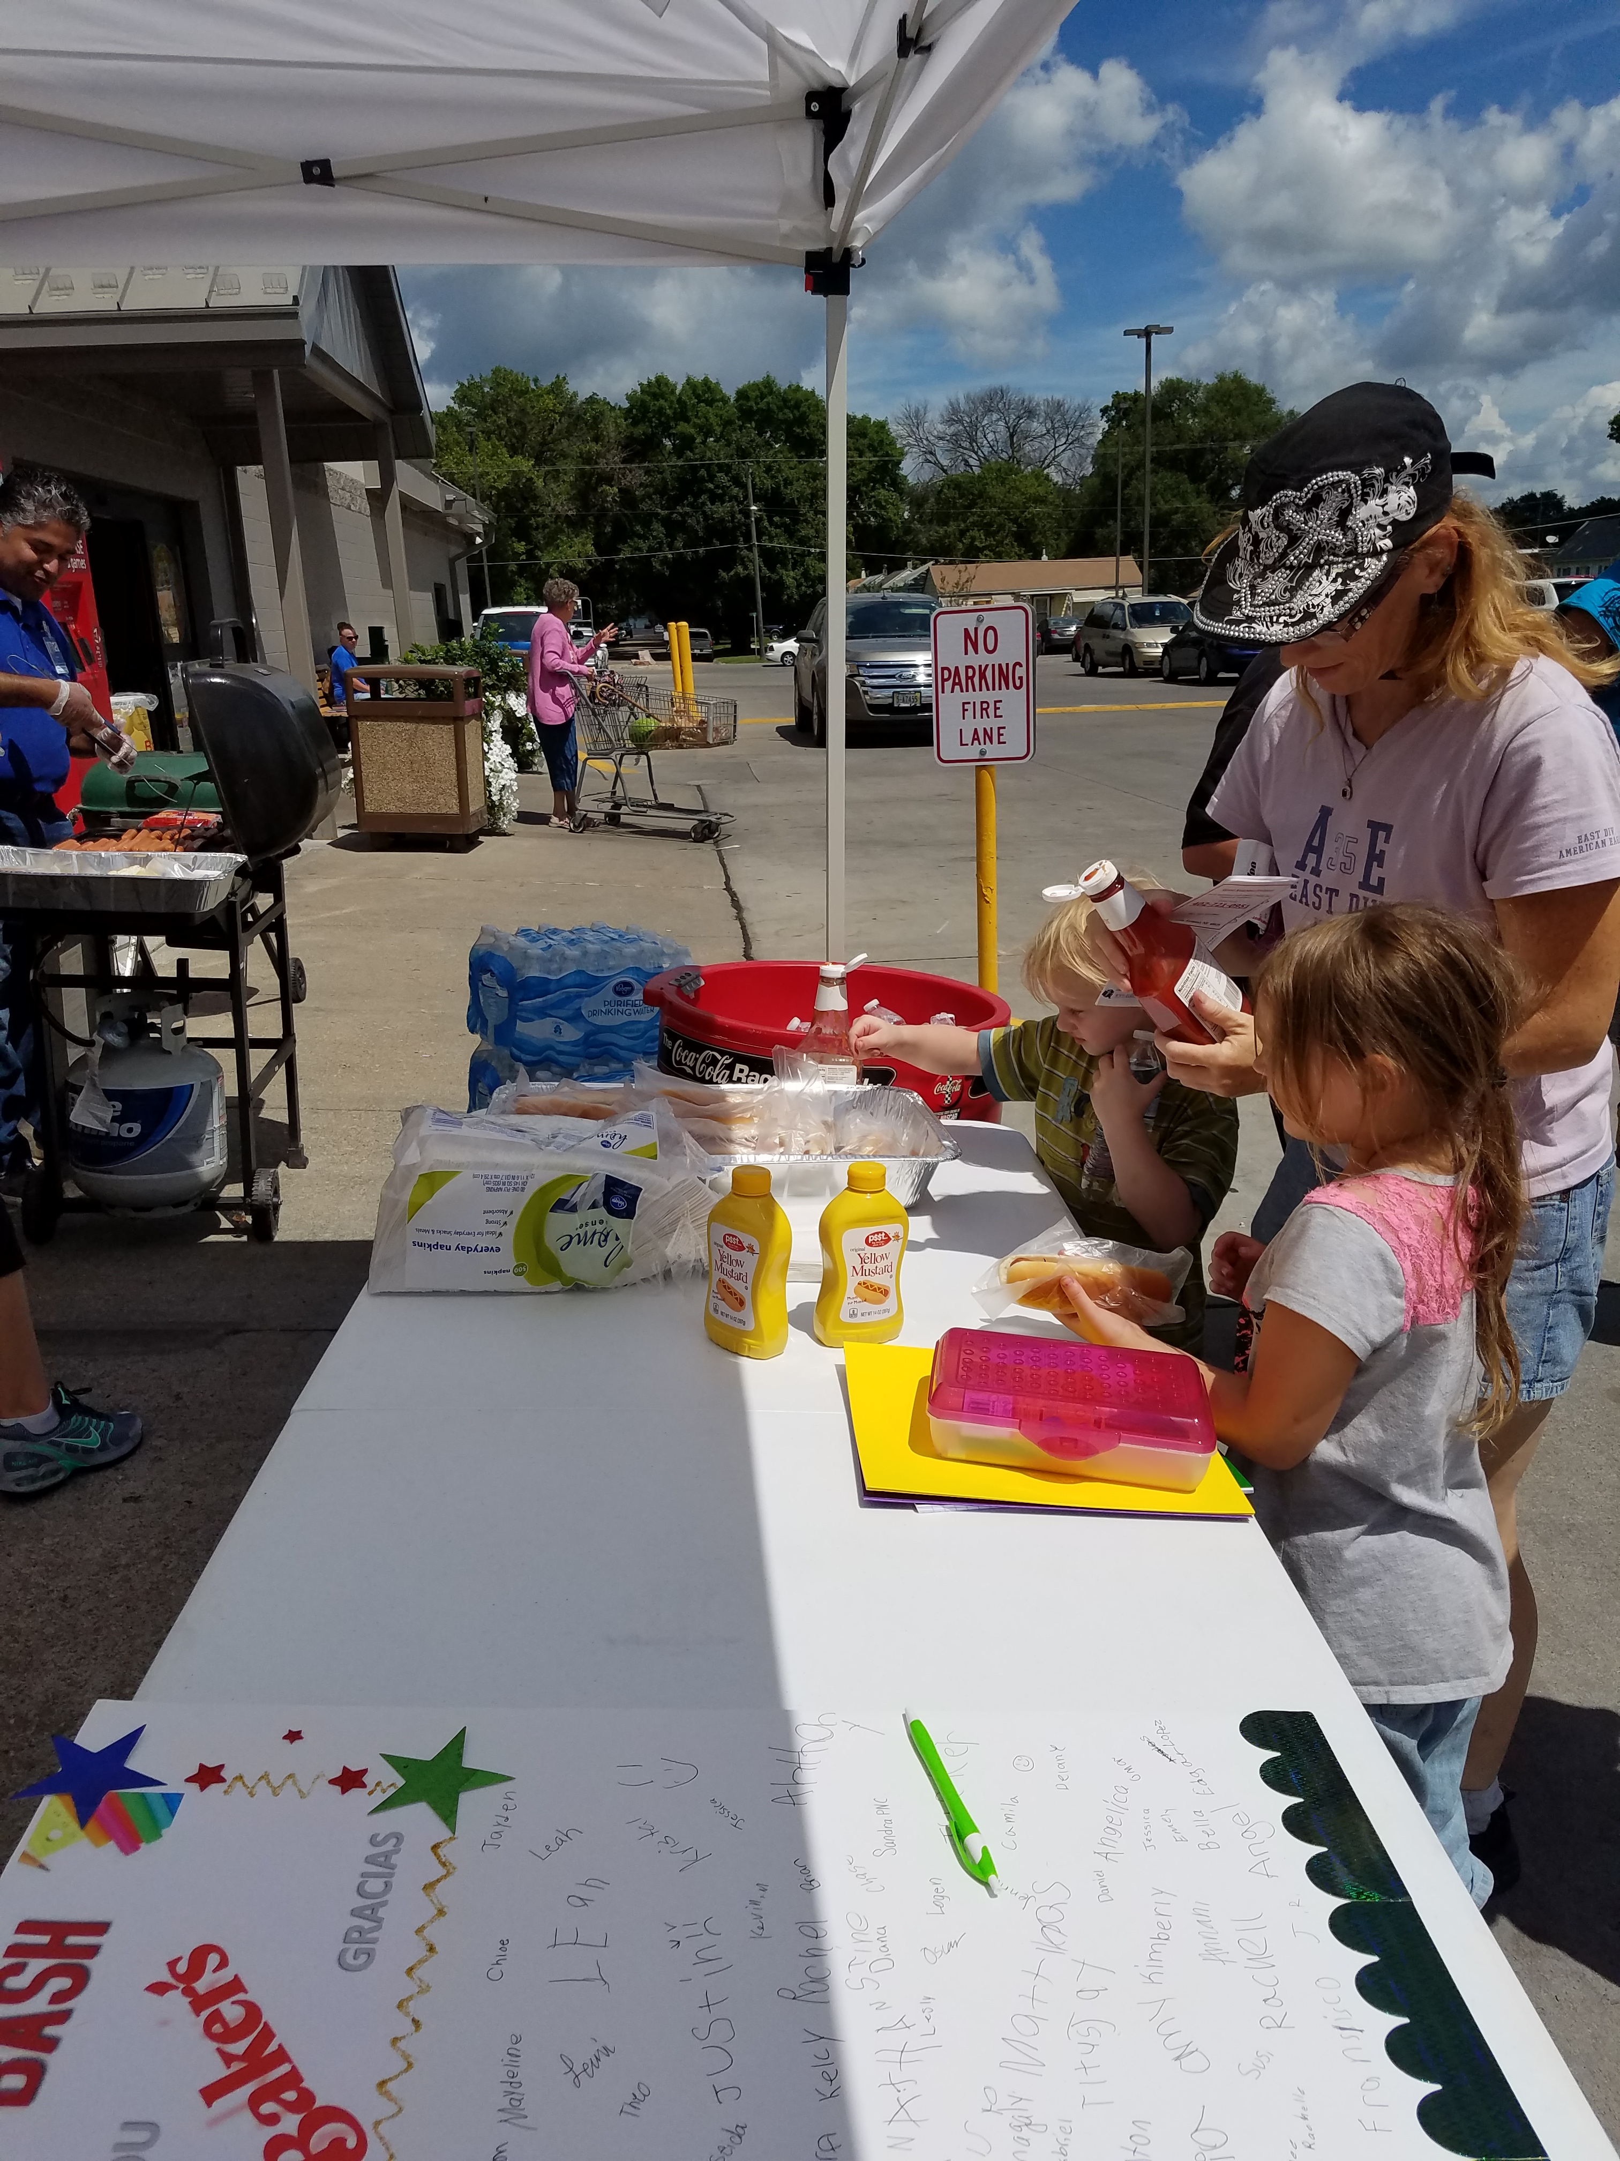
Nebraska Examples
Back to school events at a local grocery store
Store donated food, water, and even grill

Slide 15
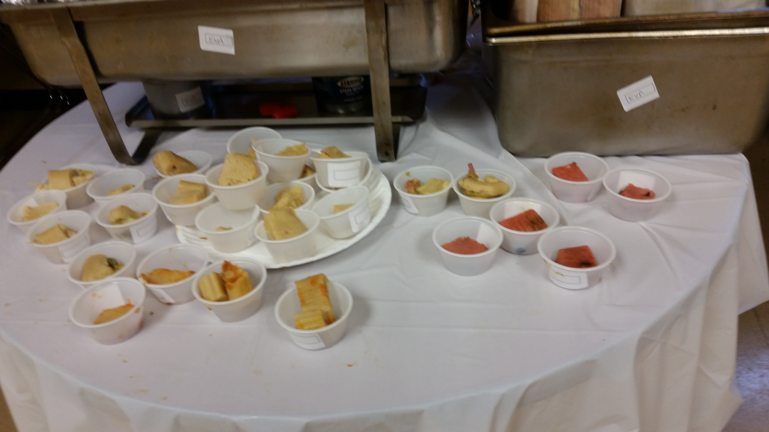
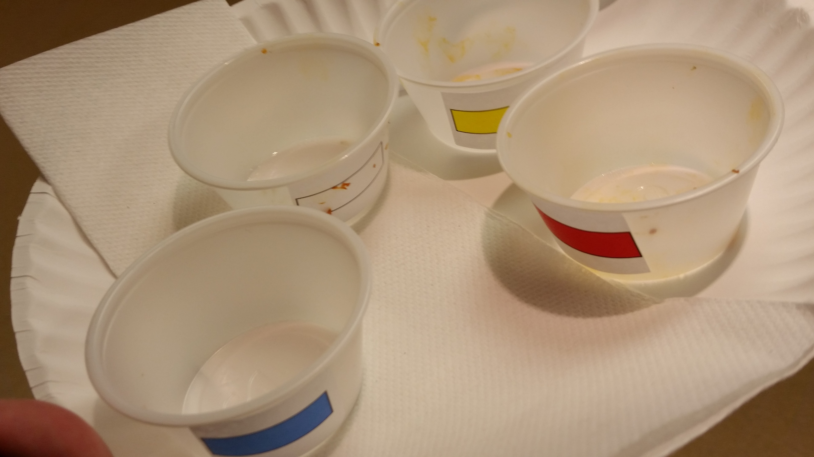
Nebraska Examples
Tamale Cook-off!
Health center employees were invited to take part in a cook-off.

Slide 17
Outreach Activity
You will have 3 minutes to think of 1 outreach idea

Slide 18
Outreach Activity
You will have 20 minutes to meet/talk to others to hear their idea

Slide 19
Discussion

Slide 20
Discussion
What idea did you find interesting?
What is one idea you plan to use?

Slide 21
Thank you!
Keshia Bradford, MPA
kbradford@hcanebraska.org
402-933-3519

